Slide 1

SERVERLESS & EVENT-DRIVEN ARCHITECTURE
Course: Cloud Computing Architecture (COS20019)
Assignment 3: Architecture Design Report
Team: Truong Ngoc Gia Hieu
Duong Nguyen Dang
Pham Dinh Duc Anh
Focus: Elasticity. Resilience. Optimization.

Slide 2

THE PROBLEM: Inefficient, Difficult Scaling
Current State: Legacy IaaS
Traditional Infrastructure-as-a-Service (VM-based) approaches are characterized by high operational costs and low agility, hindering rapid adaptation and efficient resource utilization.
Business Mandate: Cloud Transformation
Cost Optimization: Transition to a pay-per-use model to minimize idle resource expenditure.
Extreme Scalability: Design a system capable of handling unpredictable traffic spikes seamlessly.
Future-Proof: Develop a decoupled and secure architecture that can evolve with future demands.

Slide 3



OUR SOLUTION: The Serverless Shift
Serverless (FaaS)
AWS Lambda: Eliminates server management, scales instantly to zero.
Benefit: Pay only for compute time consumed, drastically reducing operational overhead.
Event-Driven (EDA)
Amazon SQS: Decouples services, enhancing fault tolerance.
Benefit: Asynchronous processing ensures system resilience and responsiveness.
Key Components: API Gateway, Lambda, SQS, DynamoDB, S3.

Slide 4
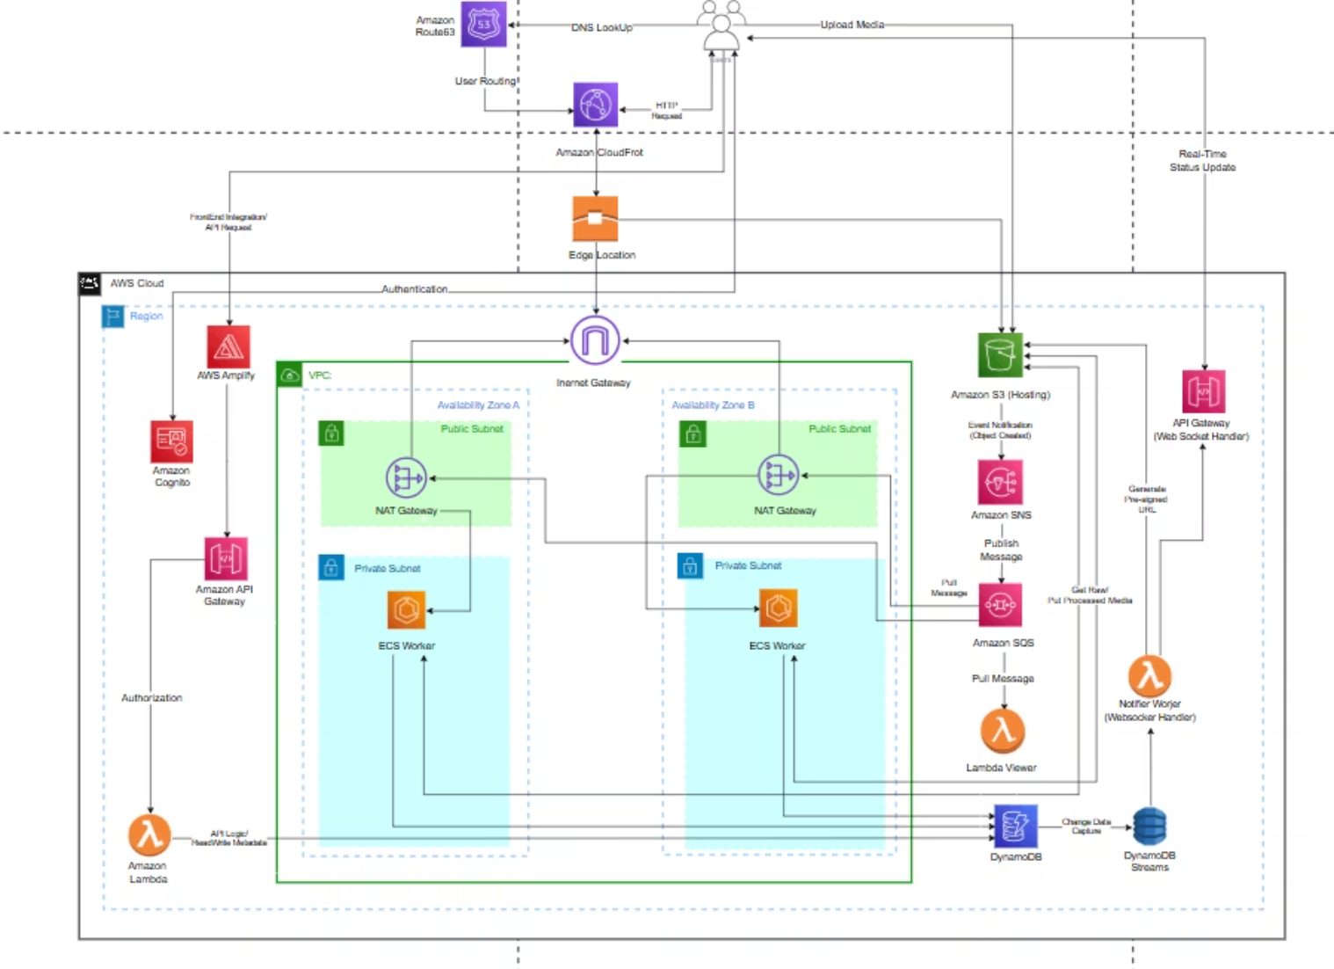
AWS Physical Architecture
"This Logical Architecture illustrates the system's functional blueprint, defining the three core processing flows—Synchronous User Access, Asynchronous Task Processing, and Real-Time Status Updates—and detailing the specific AWS components responsible for each action."

Slide 5

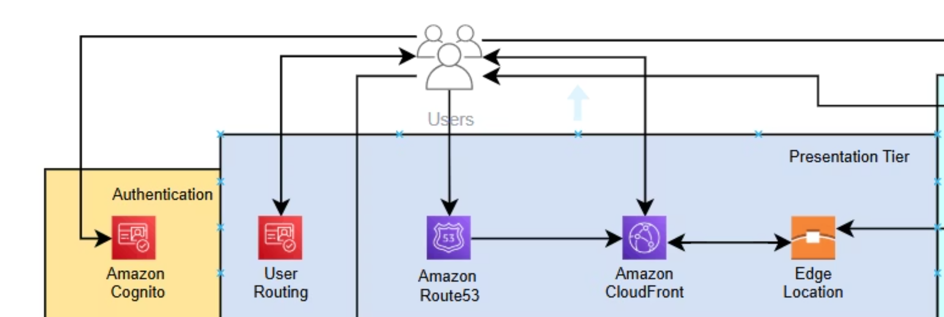
Flow 1: User Access and Metadata Mechanism

Slide 6
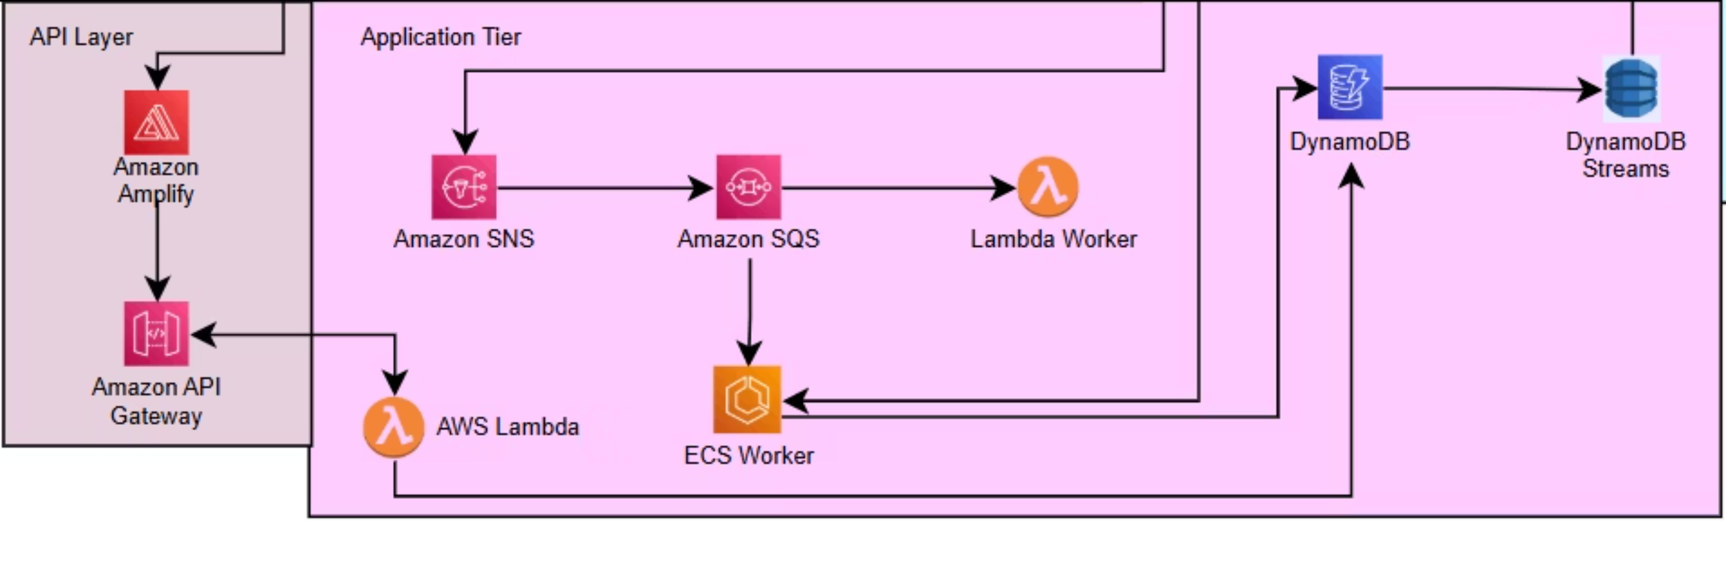
Flow 2: Asynchronous Task Processing Flow

Slide 7
Flow 3: Real-Time Status Update
This third operational flow is designed to maximize user experience by providing instantaneous feedback on the progress of asynchronous tasks, eliminating the need for client-side polling. This flow leverages reactive, stream-based services to push updates directly to the client:
Change Data Capture (CDC): The asynchronous processing worker (ECS/Lambda Worker from Flow 2) updates the job status (Processing, Completed, or Failed) in the Amazon DynamoDB table. DynamoDB Streams is enabled on this table to automatically capture these changes in near real-time.
Stream Processing: The DynamoDB Streams act as the event source, triggering a dedicated, specialized AWS Lambda Function designed exclusively for real-time notification logic. This Lambda reads the status change record from the stream.
Real-Time Push Mechanism: The Lambda function utilizes a previously established WebSocket connection managed by the API Gateway. This connection allows the Lambda to push the updated status information directly to the relevant client/browser session.
Outcome: By implementing this reactive push model, the architecture ensures high interactivity and low latency status reporting, significantly improving the overall user experience while maintaining a decoupled structure.

Slide 8
Technical Justification
Key Service Decisions (The "Why")
Compute
AWS Lambda
Scales to Zero: Ultimate cost control through pay-per-execution model, eliminating idle server costs.
Database
DynamoDB
Consistent Latency: Provides single-digit millisecond performance at any scale, ensuring a predictable user experience.
Decoupling
SQS
Message Durability: Tasks are never lost, even if consumer services are unavailable, enhancing overall system resilience.

Slide 9

Ensuring Reliability
Advanced Technical Points
01
02
DynamoDB Global Secondary Indexes (GSIs)
AWS X-Ray for Distributed Tracing
Implemented specialized NoSQL indexes to facilitate diverse and efficient query patterns, crucial for dynamic data access.
Deployed X-Ray to provide end-to-end visibility and detailed tracing, essential for debugging and optimizing the complex asynchronous workflow.
03
Idempotency with Deduplication IDs
Incorporated unique deduplication IDs to guarantee that background tasks execute exactly once, preventing data corruption or redundant processing.

Slide 10






CONCLUSION: Value Delivered
Cost Efficiency
Realized via a precise pay-per-use consumption model.
Elasticity
Achieved through AWS Lambda's auto-scaling capabilities.
Resilience
Ensured by Amazon SQS and decoupled service architecture.
Thank You! Questions?
Ready to discuss: DynamoDB Indexing strategies, advanced X-Ray analysis, and detailed cost breakdown for proposed services.

